Slide 1

Customer Retention
Analysis
Presentation
By Rakesh Chaudhary

Slide 2


Agenda…
Introduction
Main Objects
Problem Statement
Understanding EDA
Visualization
Correlation
Conclusion
Improvements

Slide 3

Introduction
Customer retention refers to a company's ability to turn customers into repeat buyers and prevent them from switching to a competitor. It indicates whether your product and the quality of your service please your existing customers. It's also the lifeblood of most subscription-based companies and service providers.
“Customer retention is more than giving the customer what they expect; it is about exceeding their. expectations so that they become loyal advocates for the brand.”

Slide 4

Problem Statement
Customer satisfaction has emerged as one of the most important factors that guarantee the success of online store; it has been posited as a key stimulant of purchase, repurchase intentions and customer loyalty. A comprehensive review of the literature, theories and models have been carried out to propose the models for customer activation and customer retention. Five major factors that contributed to the success of an e-commerce store have been identified as: service quality, system quality, information quality, trust and net benefit. The research furthermore investigated the factors that influence the online customers repeat purchase intention. The combination of both utilitarian value and hedonistic values are needed to affect the repeat purchase intention (loyalty) positively. The data is collected from the Indian online shoppers. Results indicate the e-retail success factors, which are very much critical for customer satisfaction.

Slide 5
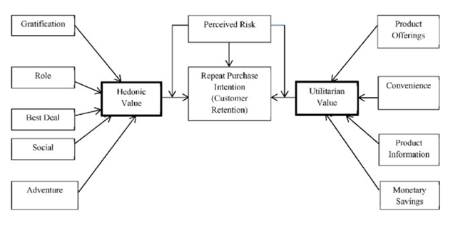
Diagram Flow

Slide 6





Main Objects
The Main object of the our problem statement is to apply ML analytics skills to findings and conclude that would help us to find customers retention for E-retail company using their data of user provide all period of time.
We have to use some machine learning tools to find patterns into customers behavior according to their likes and dislikes that will influenced the target being which online retail website customer recommend the most.
The data is collected from the Indian online shoppers. Our Dataset consists of reviews and feedbacks of customers on 5 top Indian Online Retailers : Amazon, Flipkart, Snapdeal, Myntra and Paytm

Slide 7
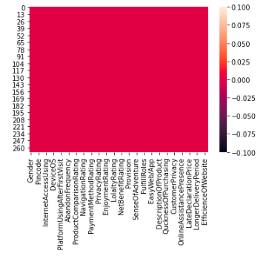
Understanding The EDA
HeatMap
Our dataset have 269 rows and 71 columns present.
The Number of columns is quite enough.
* Except pin code all the columns are object data type.
* Seems no columns has any null value.
There are no missing value present in our dataset
The Target Variable is present at the last of the dataset. “The Recommend to as a friend”.

Slide 8
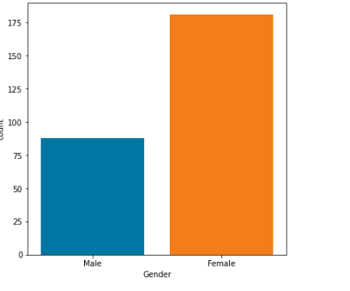
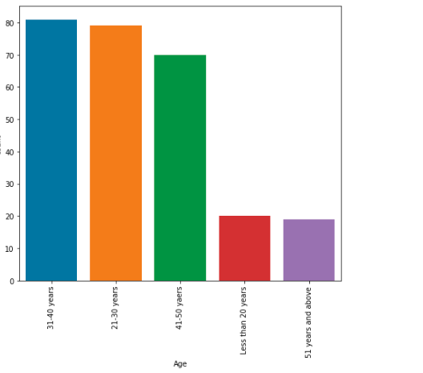
Visualizations:
Gender:- As we assume that there are female customers are more than male customers. And if we compare it with real time than Yes Females are most like to do shopping.
Age:- We can see from above graph that 21 to 40 year Aged people mostly do the online shopping.

Slide 9
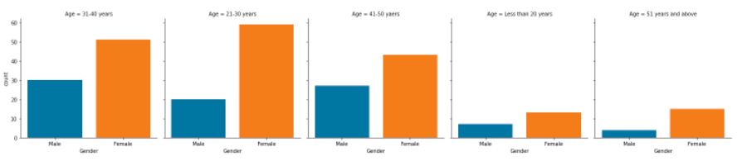
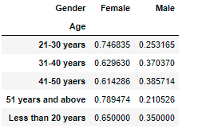
Age Vs Gender
We observe from above graph that almost every age group the count of female customers is more than Male customers.
we can say that females are most like to do online shopping.

Slide 10
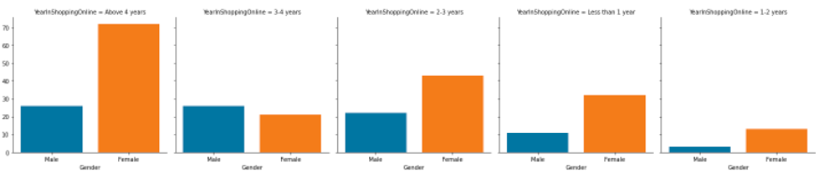
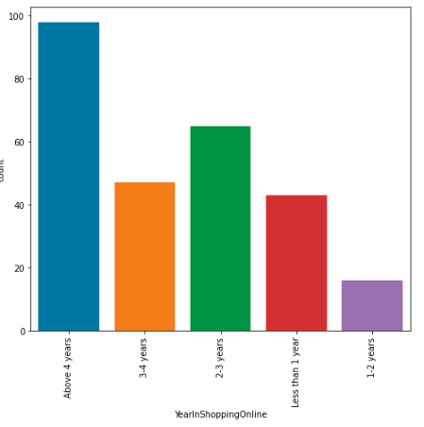
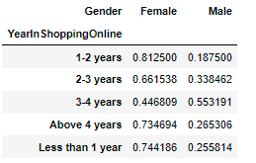
How many times you have made an online purchase in the past 1 year?
- As we can see that most of the customers are doing online shopping after more than 4 years.
-We can see there is amazing fact that male customers count is higher than female customers who are doing online shopping after 3 to 4 year.
-Female customers are doing shopping after 1- 4 year gap most of the time.

Slide 11
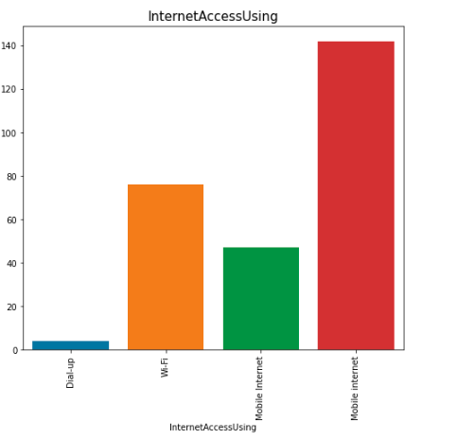
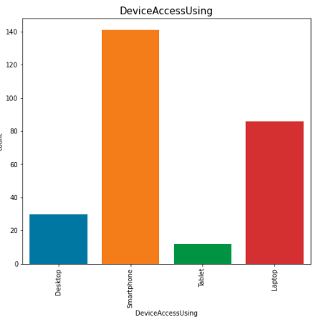
How do you access the internet while shopping on-line?
Most of the customers are use Smartphone for online shopping and similarly in other hand very less people are use Tablet for online shopping
Most of the customers use mobile Internet while online shopping

Slide 12
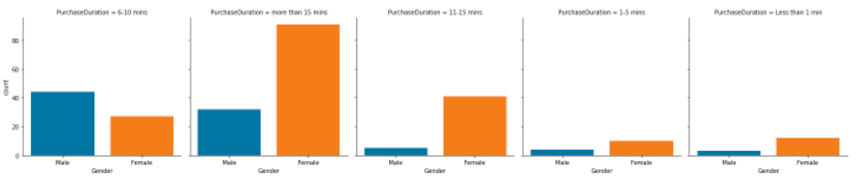
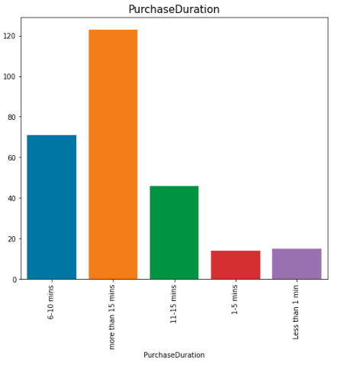
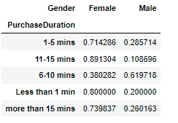
Purchase Duration
* In first count graph we can see that most of the customers take time more than 15 minutes for purchase one item.
* In second factor plot we can see that Most of the male customers take time 6 to 10 minutes for purchase one time.
* Also we can see that Female customers are take time less than 1 minute as compare to male customers.

Slide 13
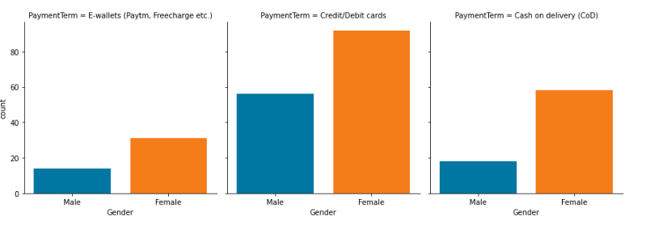
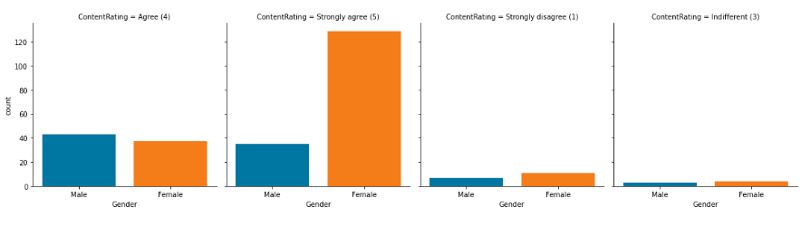
Mostly Female customers are choose payment method as cash on delivery as compare to male customers. Below Graph:
* Most of the customers are satisfied with content of the product.
* From which Female customers are more then satisfied with content of the product. *Below Graph*

Slide 14
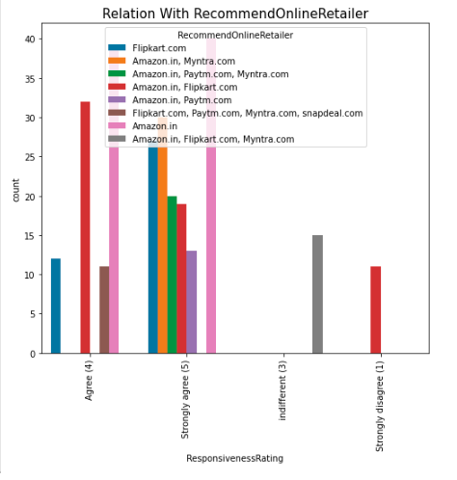
Relation With Recommend E-Tailer
Customers are not quite sure to rate about responsiveness of the online shopping website when they do shopping with amazon.in,Flipkart.com,Mytra.com together.
When Customers are doing shopping with amazon.in and Flipkart.com together, they are strongly disagree with responsiveness of the website.

Slide 15
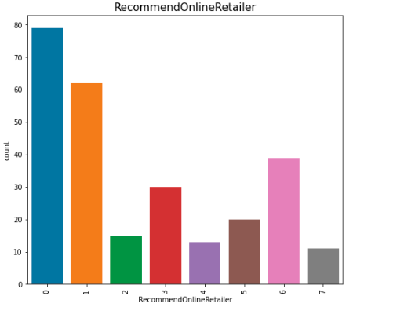
Visualize The Target Variable
Most of the customers are recommend Amazon.in to his other friend for online shopping.
Flipkart is second highest recommend website for online shopping.
paytm.com and snapdeal are very less recommend website for online shopping by customers.

Slide 16
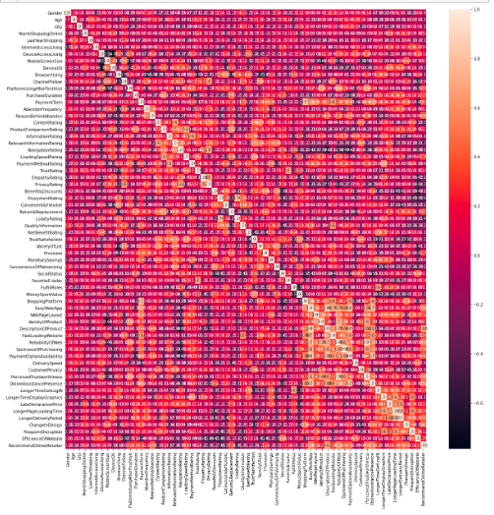
Plotting Heat map
I used the heatmap on the encoded dataset to see the correlation details between the columns.
Even on the Jupyter Notebook the picture was too tiny however seeing the color combinations I was able to figure out that there is no multi co linearity concern between the columns.

Slide 17
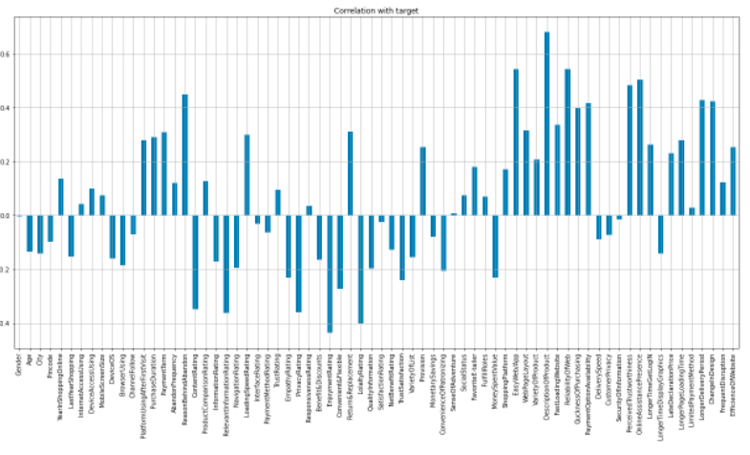
Correlation With Target Variable
* 'InterfaceRating','SatisfactionRating','SecurityOfInformation' features are very less negatively correlated with target variable.
* 'ResponsivenessRating','SenseOfAdventure','LimitedPaymentMethod' are very less Positively correalted with target variable.
*'ReasonBehineAdventure','EasyWebApp','DescriptionOfProduct','realiabilityOfWeb','PerceivedTrustworthness','OnlineAssistance Presense' features are highest correalted with target varieble.
*'ContentRating','RelevantInformationRating','PrivacyRating','LoyalityRaing' are storngly negatively correalted with target variable.

Slide 18
Conclusion
Amazon is most recommended by 81.4% of the Customers, 47% of the Customers recommended Flipkart. Paytm has recommended by 16.4% of the Customers. Myntra is recommended by 28% of the customers. Snapdeal is the least recommended online retailed with only 4% of recommendation Rate.
Based on overall observations the first 47 features provide insights on how e-retail is helpful and growing based on customer inputs. The data explained how the online platform has been used more often in which CITY, PIN CODE, AGE etc. It also showed us that in some factors there is less importance given to contribute to the success of an e-commerce store, so based on that we could remove those factors and keep all the important factors. Also we could improve on some factors that influence the online customers repeat purchase intention.
Apart from the first 47 features the rest of the features showed which online platform has been used more based on the success factors. Based on the case study for customer activation and retention, Amazon is the most reliable and has been fulfilled all the customer requirements. After Amazon the data showed Flipkart has been used more for online shopping.
Amazon and Flipkart have highest efficiency as compare to other websites. And Paytm.com and Snapdeal.com take highest time for delivery of the product. So based on the research factors Amazon and Flipkart are the e-commerce platform which are having the combination of both utilitarian and hedonistic values to keep the repeat purchase intention (loyalty) positively.

Slide 19
Improvements:
Amazon.in:- During promotions, try to give a disturbance free shopping experience to customers. Give more payment options to customers and reduce the delivery time of the products. Amazon should have to do availability of complete information of the products.
Flip Kart:- During promotions, try to give a disturbance free shopping experience to customers. Give more payment options to customers, try to give the price early during promotion. Flipkart and Amazon almost share the same feedbacks with varying percentages as the only difference. In other hand presence of online assistance through multi-channels and reliable website or app, perceived trustworthiness.
PayTM.com:- Reduce the delivery time of the products during promotions, try to give the price early during promotion and during promotions, try to give a disturbance free shopping experience to customers and paytm should late declaration of price and discounts.
SnapDeal:- Convenient to use and 54% of the customers are happy about the availability of financial information security. Also there is no one has expressed to recommend Snapdeal to a contact as it has the most negative feedbacks among all other websites.
Mytra:- Mytra should try to give the price early during promotions and reduce the delivery time of the products during promotions. In other hand convenient to use and also a good website and availability of several payment options. It has faster products delivery as well.

Slide 20


